Slide 1



Lakshmanan
16-OCT-2024

Slide 2
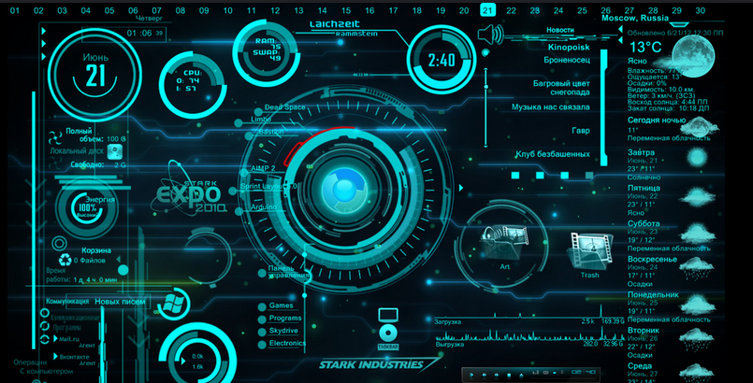
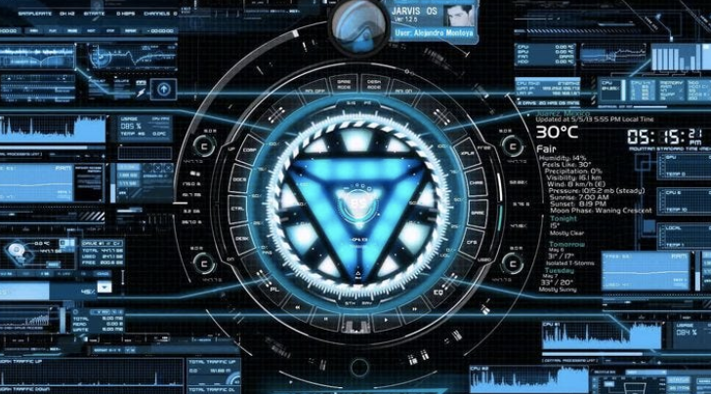
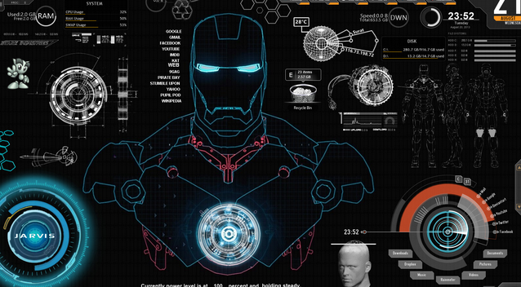
History of AI :
2019: Introduction of F.R.I.D.A.Y. as a successor to J.A.R.V.I.S., enhancing user interaction and optimizing mission control.
2020: Integration of machine learning capabilities allows F.R.I.D.A.Y. to adapt and learn from user preferences and behaviours.
2021: F.R.I.D.A.Y. demonstrates advanced data processing capabilities, improving mission efficiency and decision-making.
History of AI :
2022: F.R.I.D.A.Y. showcases real-time data analysis during combat scenarios, providing strategic advantages in battles.
2023: Enhanced natural language processing features create more credible communication and intuition between Iron Man and F.R.I.D.A.Y.
2024: Continued evolution of AI systems reflects advancements in technology, paving the way for future innovations in AI applications.
Key Features of Iron Man's AI:
Advanced Language Understanding:
Iron Man's AI utilizes sophisticated algorithms, enabling it to comprehend and respond to complex commands with high accuracy and contextual awareness
Seamless Multitasking Capabilities:
The AI can manage multiple tasks simultaneously, allowing Iron Man to execute intricate operations, such as piloting the suit while analyzing data and communicating with allies in real-time.
Adaptive Learning Mechanism:
Through continuous interaction, the AI refines its understanding of user preferences and operational patterns, enhancing its efficiency and effectiveness in various scenarios.

Slide 3

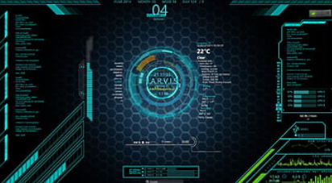
The Role of AI in Enhancing Human Decision-Making :
Data-Driven Insights: AI systems can analyze vast amounts of data quickly, providing actionable insights that enhance human decision-making in various fields, from healthcare to finance..
Predictive Analytics: By utilizing predictive models, AI can forecast potential outcomes based on historical data, allowing humans to make informed decisions with a clearer understanding of risks and benefits.
Cognitive Assistance: AI can act as a cognitive partner, augmenting human intelligence by offering recommendations and ultimately leading to more effective and efficient decision-making.
Lessons from Iron Man: AI in Real-World Applications
Iron Man's AI exemplifies the importance of real-time
data processing in critical situations, showcasing how advanced AI can enhance situational awareness and decision-making in fields such as emergency response and military operations.
Cognitive Assistance: AI can act as a cognitive partner, augmenting human intelligence by offering recommendations and ultimately leading to more effective and efficient decision-making. Cognitive Enhancement: The ability to improve memory, process information faster, or even upload new skills to the brain
could theoretically be possible.
The interactions between Iron Man and his AI highlight the potential for effective human-AI collaboration, emphasizing how AI can augment human capabilities in various industries, including healthcare, engineering, and finance, leading to improved outcomes and efficiency.

Slide 4

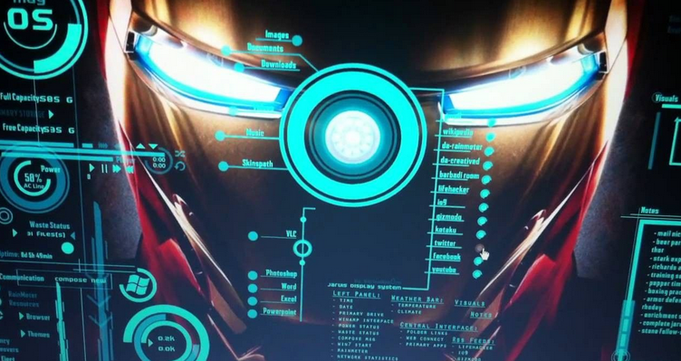
Understanding Human Augmentation and Man-Machine Collaboration:
Medical Uses (Short-term):Treating Neurological Disorders: Early targets include restoring motor function in individuals with paralysis, treating diseases like Parkinson’s, epilepsy, Alzheimer’s, and potentially addressing conditions such as depression, anxiety, or addiction.
Prosthetic Control: It could allow amputees or paralyzed individuals to control prosthetic limbs or robotic devices using just their thoughts.
Understanding Human Augmentation and
Man-Machine Collaboration:
Defining Human Augmentation
Human augmentation refers to the enhancement of human capabilities through technology, including physical, cognitive, and sensory improvements that facilitate better performance in various tasks.
Man-Machine Collaboration Dynamics
Effective collaboration between humans and machines involves leveraging AI systems to complement human skills, leading to improved efficiency, decision-making, and innovative problem-solving in complex environments.
Ethical Implications of Augmentation
The integration of human augmentation technologies raises ethical questions regarding privacy, autonomy, and the potential for inequality, necessitating careful consideration of societal impacts and regulatory frameworks.

Slide 5
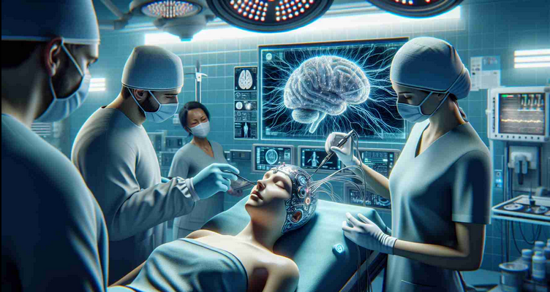
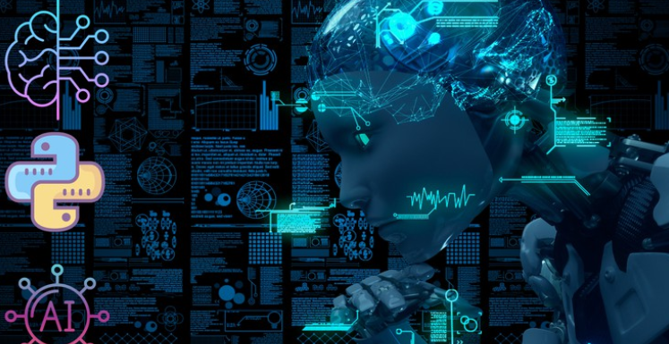
The Future of AI: What Can We Learn from Iron Man?:
Innovative AI Integration Iron Man's AI systems exemplify the potential for seamless integration of advanced technologies in everyday life, suggesting future AI applications could enhance personal productivity and decision-making across various sectors. Direct Brain-Machine Interaction
Human-AI Synergy The collaboration between Iron Man and his AI highlights the importance of developing systems that augment human capabilities, paving the way for more effective partnerships in fields such as healthcare, education, and engineering.
Mitigating Risks with AI:
AI systems can enhance risk management by analyzing vast datasets to identify potential threats and vulnerabilities, allowing organizations to implement proactive measures. Personalized insights derived from AI algorithms enable tailored strategies that address specific risks, improving decision-making processes and resource allocation. This approach not only minimizes potential losses but also fosters a culture of informed risk-taking, ultimately leading to more resilient operational frameworks in various sectors.
Technological Limitations:
Current AI technologies, while advanced, still lack the comprehensive understanding and contextual awareness exhibited by J.A.R.V.I.S. This includes limitations in natural language processing, emotional intelligence, and real-time decision-making capabilities that are essential for seamless human-AI interaction in complex environments.

